Slide 1
Global Health (GH) Roundtable Schedule
2:00 to 2:30 Reception
2:30 to 2:40 Welcome by Maggie and Introduce Panel
2:40-2:50 Each person introduce self and what is their connection to GH
2:50 to 3:10 Carol-Global Health + RHCI and SL
3:15 – 3:55--Panel discussion and Q and A
Panel to include: Alice, Gary, Kumba, Sheku
3:15 to 3:35 initial questions by: Sarah, Julie and Marie
3:35 to 3:55 Then Q and A from the audience
Conclusion and thank you Maggie

Slide 2
General Questions
What are the Challenges in Health care in Sierra Leone?
What are health needs of children in SL and how they be addressed?
How does agriculture and nutrition affect health in Sierra Leone? (Gary)

Slide 3
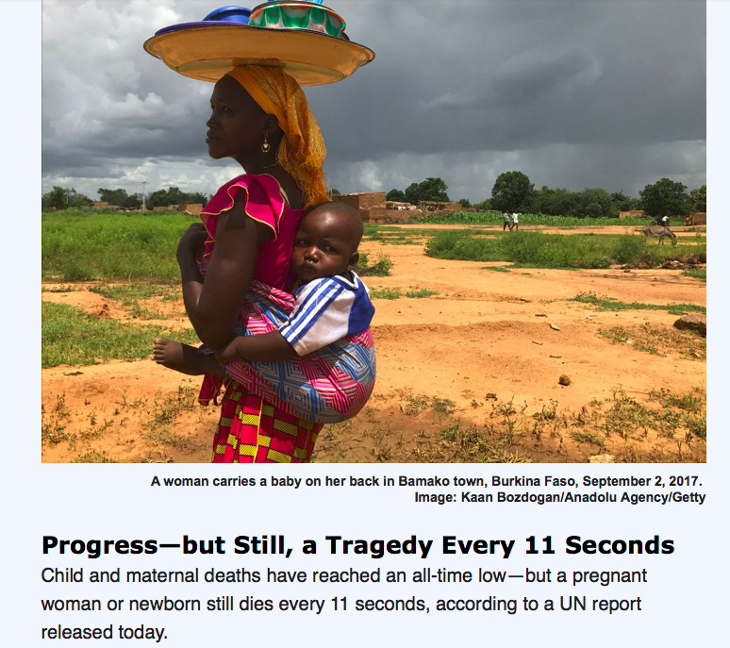

Slide 4
Global Health Roundtable
September 29, 2019
Notes:
Welcome to all of you. My presentation with provide an overview of Global Health and then focus more specifically on rural Sierra Leone.
I am currently the volunteer E. D. of RHCI and have had the privilege of traveling to Tikonko in Sierra Leone five times over the past 6 years. My experiences there have been life-changing and it is my passion to do all I can for as long as I can to empower the health care workers in the Tikonko Chiefdom to provide better health care for their communities.

Slide 5
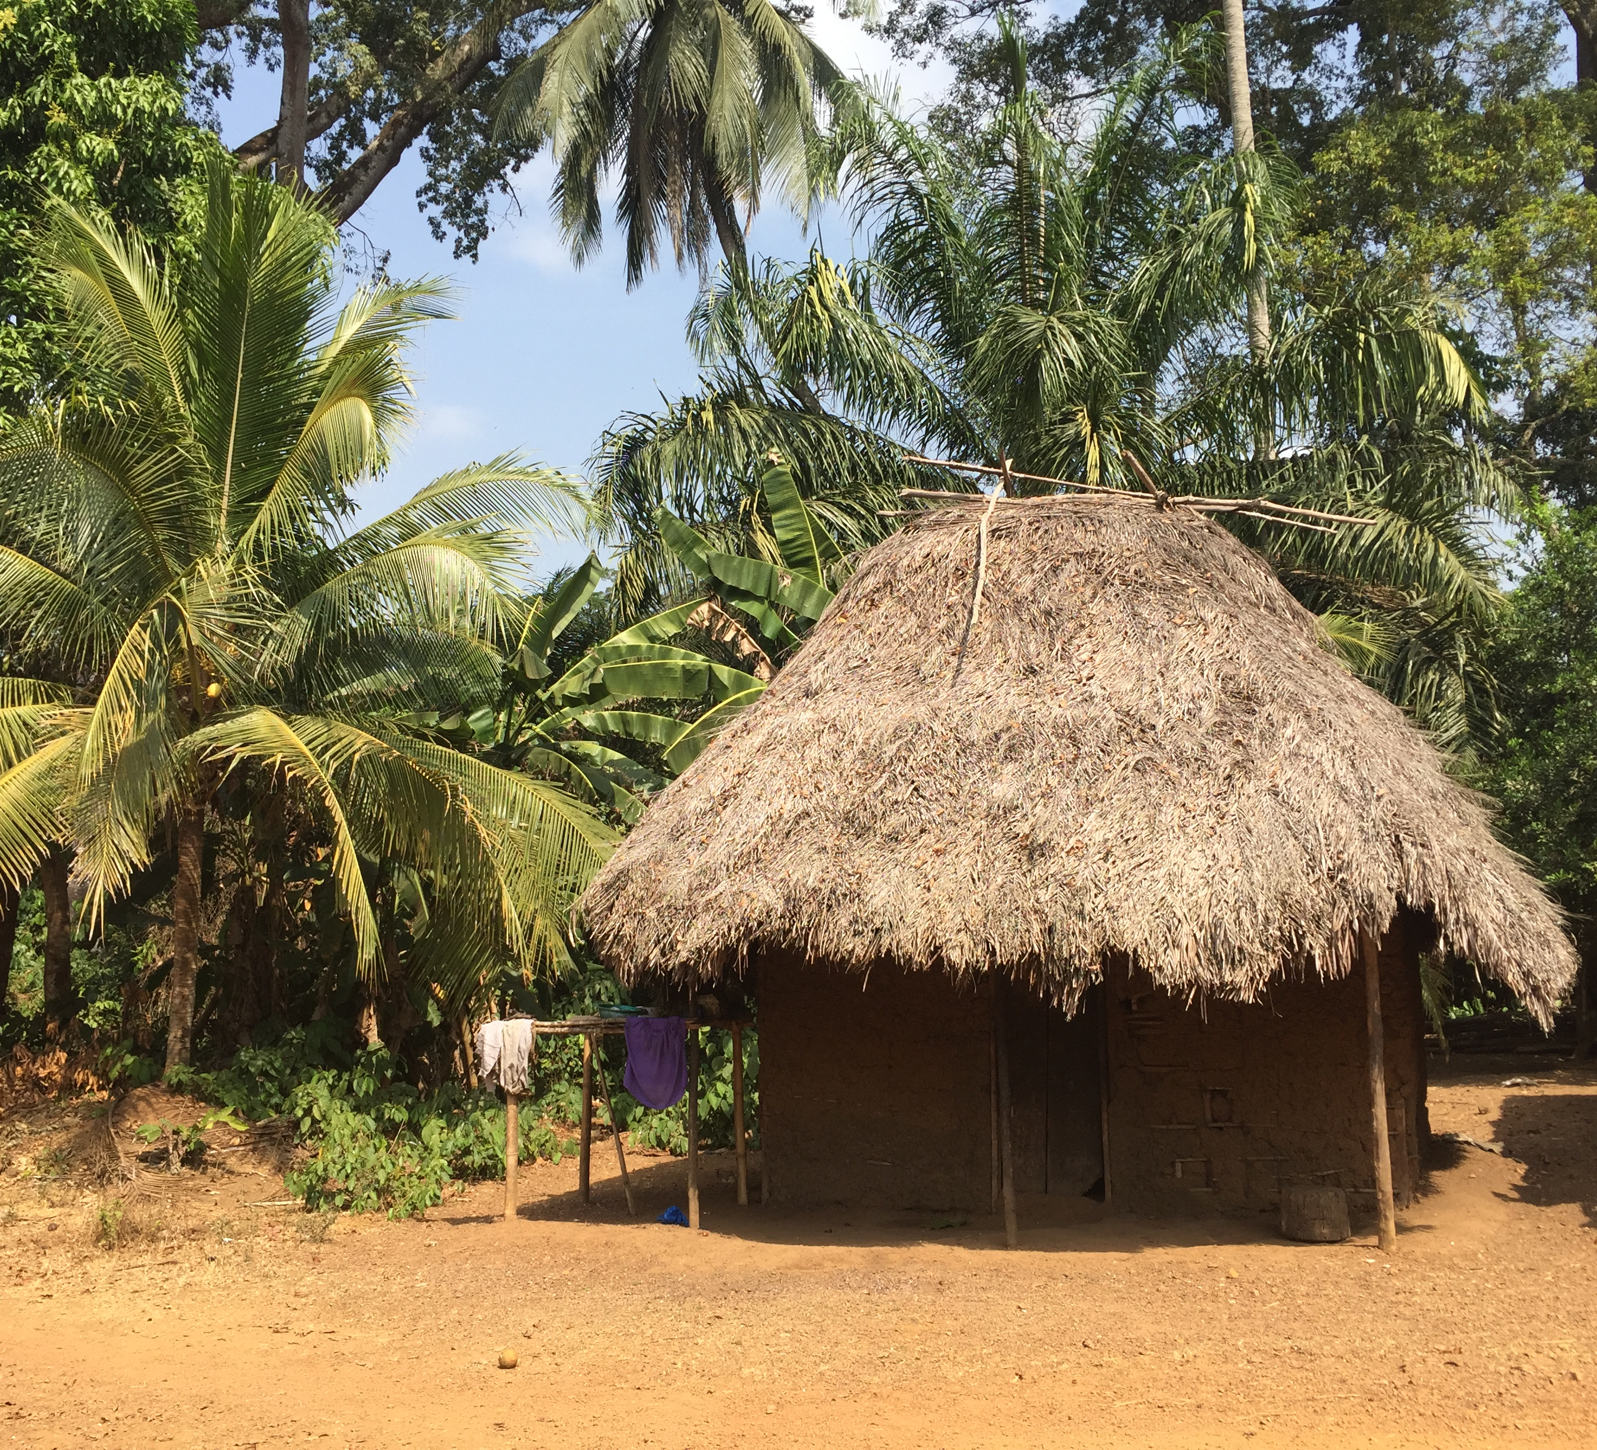
Sierra Leone
Notes:
This picture is from rural Sierra Leone, with the mother and baby picture one that I took in January of this year. The location of the hut on the right isJulian, which is a remote village in the Tikonko Chiefdom that has benefited from RHCI’s work.

Slide 6
What is Global Health?
1.
2.
3.
4.
5.
6.
Notes:
But I would like to start out with this question. What is global health?
I’d like each table to take a few minutes to answer this question. (or ask participants to respond verbally to this question).
List answers.

Slide 7
What is Global Health?
An area for study, research, and practice that places a priority on improving health and achieving health equity for all people worldwide’. (Koplan 2009)
collaborative trans-national research and action for promoting health for all. (Global Health Action 2010)

Slide 8
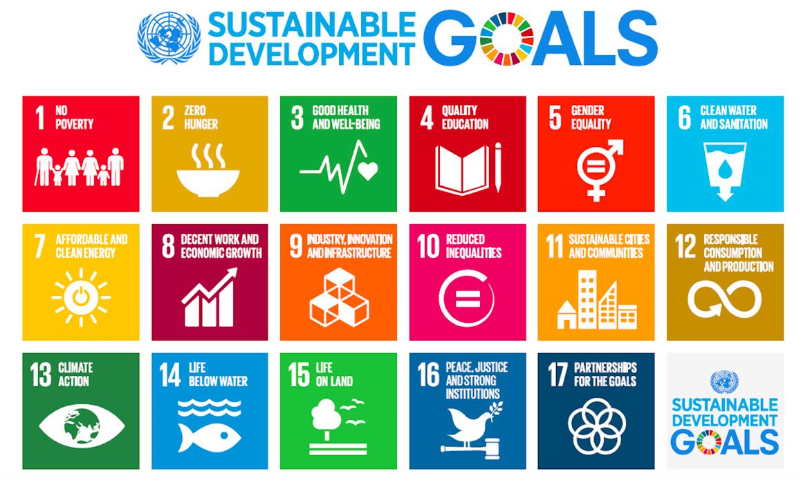
United
Nations
2015-2030
Notes:
IN 2000, the United Nations developed a set of 8 Millennial development goals that its member states were striving to achieve by 2015. Much progress was made but many of the goals were not achieved, especially in Subsaharan Africa. Such as a substantial. decrease in maternal and child mortality.
The New UN goals are called the Sustainable Development Goals, and they are illustrated in this slide. #3 is the primary goal that RHCI is working on, but as you can see all of these goals have a direct or impact on good health and well-being.

Slide 9
SOCIAL DETERMINANTS OF HEALTH
Socioeconomic status;
occupation and employment status, income, wealth
Literacy and Educational status
Place of residence (urban vs. rural)
Ethnicity
Gender
Religion
Age, disability, sexual orientation, other vulnerable groups

Slide 10
Gapminder Data: Hans Rosling
https://www.youtube.com/watch?v=jbkSRLYSojo
Blue: Sub-Saharan Africa
Red: Asia
Yellow: USA
Brown: Europe
Green: Middle East
2017
Notes:
Now I will show a short video by Dr. Hans Rosling, He was a Swedish Physician and global health authority, having worked in Mozambique, India, and DRC. He developed Gapminder wjhich uses global health information and transforms it visually to help understand it better. In this video he will talk about income (or wealth) and life expectancy (which is a marker for how healthy one is.
Any commnets on the video? Sierra Leone is one fo the blue dots and US one of the Green.

Slide 11
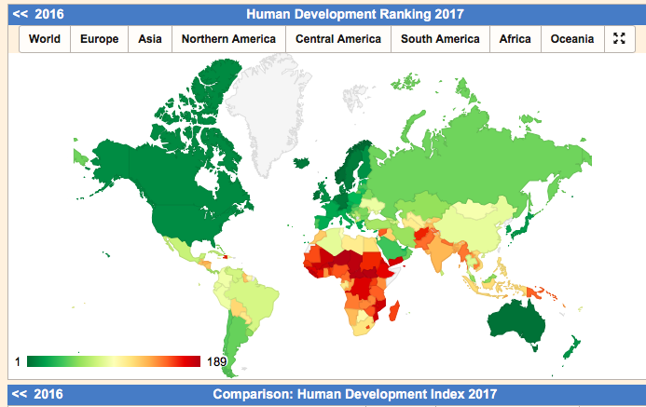
HDI is based on
Education
Income
Life expectancy
HDI Rank of Sierra Leone is 184
Notes:
This map also illustrates the state of the world through the Human Development ranking. The higher the rank (or closer to one) the better the development of the country, so you can see the dark green is the US, Canada, Western Europe, Australia, Japan, and New Zealand. The number is based on education, income, and life expectancy. The darker the red the worse the ranking, with Sierra Leone ranking 184 of 189 in 2017.

Slide 12
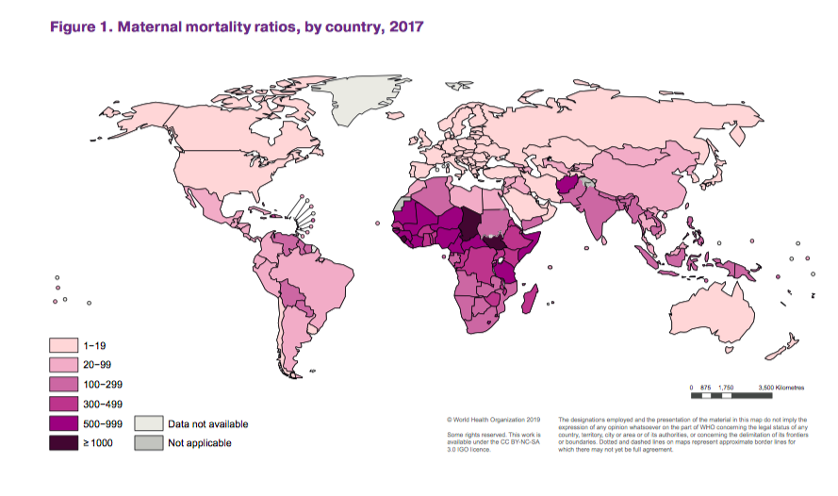
Trends in maternal mortality: 2000 2017
Maternal
Mortality in
The USA is
approx. 25
2000
2005
2010
2015
2017
Sierra Leone | 2480 | 1760 | 1360 | 1180 | 1120 | 55 % decrease
Notes:
Throughout the world there is a vast difference in the maternal mortality rate. The light pink countries have the lowest maternal mortality, and the darker the color, the higher the rate. Note on the bottom the numbers for Sierra Leone: This rank is based on number of women dying per 100,000 live births.
In the US, the MMR is 25/100,000. Sierra Leone’s Maternal mortality rate is 45 times higher (or 4500% more)

Slide 13
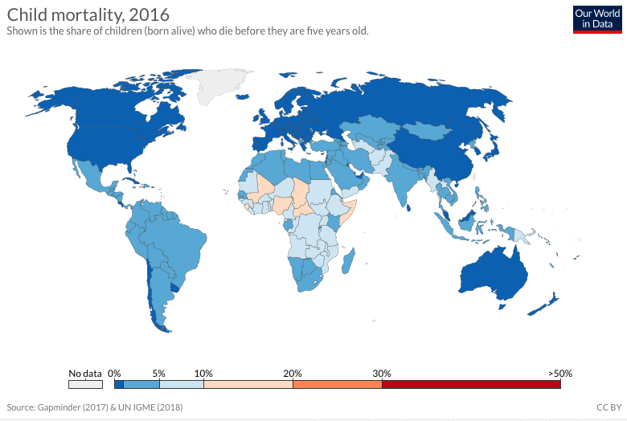
Notes:
Child mortality is measured by the per cent of children who were born alive but died before age 5. Sierra Leone is currently at ~11%.
In the USA, 6.6 die per 1000 or 0.6% (less than one percent)

Slide 15
Global Health Actors
Agency | Example
Multilateral International Agencies | WHO (World Health Organization), UN agencies
Bilateral Aid and Development Agencies | USAID, DFID (British), CIDA (Canada)
Technical Health agencies | CDC (Center for Disease Control and Prevention)
Public Private Partnerships | Global Fund to Fight AIDS, TB and Malaria
Business Interests | Big Pharma (Merck and others)
Faith Based Organizations | World Vision, Islamic Relief Worldwide
Nongovernmental Organizations—NGOs | RHCI; Save the Children, Doctors without Borders; Partners in Health; Helen Keller Int
Research related agencies | U of MN; National Institute of Health
Notes:
Who are the actors in the vast field of Global Health? There are many and this list gives you a brief overview of some of them.

Slide 16
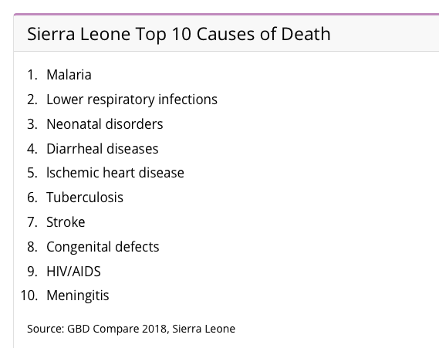
Communicable Diseases
VS. noncommunicable diseases
Notes:
In poor or developing countries, more of the deaths are caused by communicable (or infectious) diseases. See the list of the top 10 causes of death in Sierra leone. As countries develop and life expectancy increases, more of the deaths are caused by NON-Communicable diseases such as Heart disease or cancer.
In contrast in US , the cause of death is more likely to be NON communicable diseases.
Heart disease. The deadliest disease in America.; Cancer. ... Septicemia. ...
Chronic lower respiratory disease. ... Stroke. ... Unintentional injuries. ... Alzheimer's disease. ... Diabetes. ...

Slide 17
THE PATH OUT OF POVERTY BEGINS WHEN THE NEXT GENERATION CAN ACCESS QUALITY HEALTHCARE AND A GREAT EDUCATION.
ALL LIVES HAVE EQUAL VALUE
we are impatient optimists working to reduce inequity
Quotes from the Gates Foundation website
Notes:
Recently the Gates Foundation, a major player in Global Health, came out with a report and this is a quote from their website.

Slide 18
Sierra Leone - Bo – Tikonko Chiefdom
The city
Of Bo
Tikonko
Notes:
Now I’m going to focus on Sierra Leone and RHCI’s work there.
Does everyone know where Sierra Leone is located?
Where in Sierra Leone does RHCI Work?

Slide 19
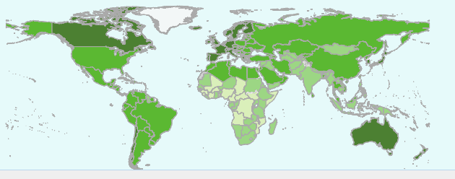
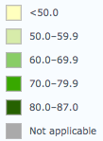
Life expectancy SL-50.1; US- 79.3; Global- 71.3
Sierra Leone
Notes:
Life expectancy is low in Sierra Leone, close to 30 years less than in the US.

Slide 20
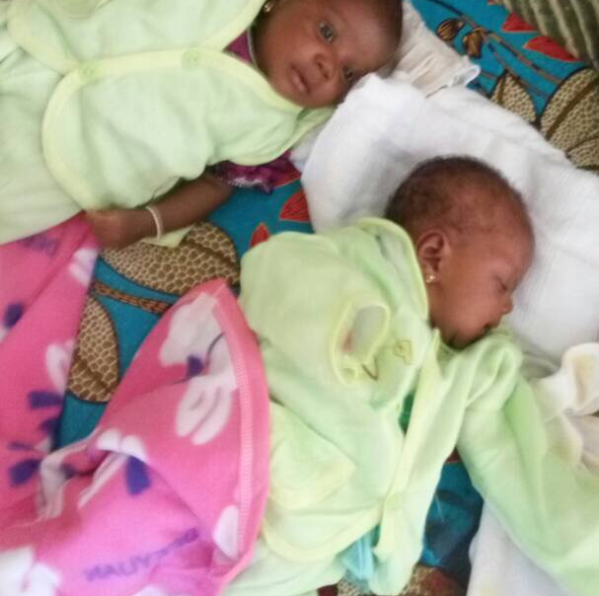
RHCI’s Mission
To partner with rural communities in Sierra Leone in redeveloping health care systems
to overcome one of the highest maternal and child mortality rates in the world.
Notes:
RHCI was founded in 2011 by Alice Karpeh, her friends in the SL community and other committed health care workers.
Read Mission.
RHCI is working on development, with the goal of improving health.

Slide 21
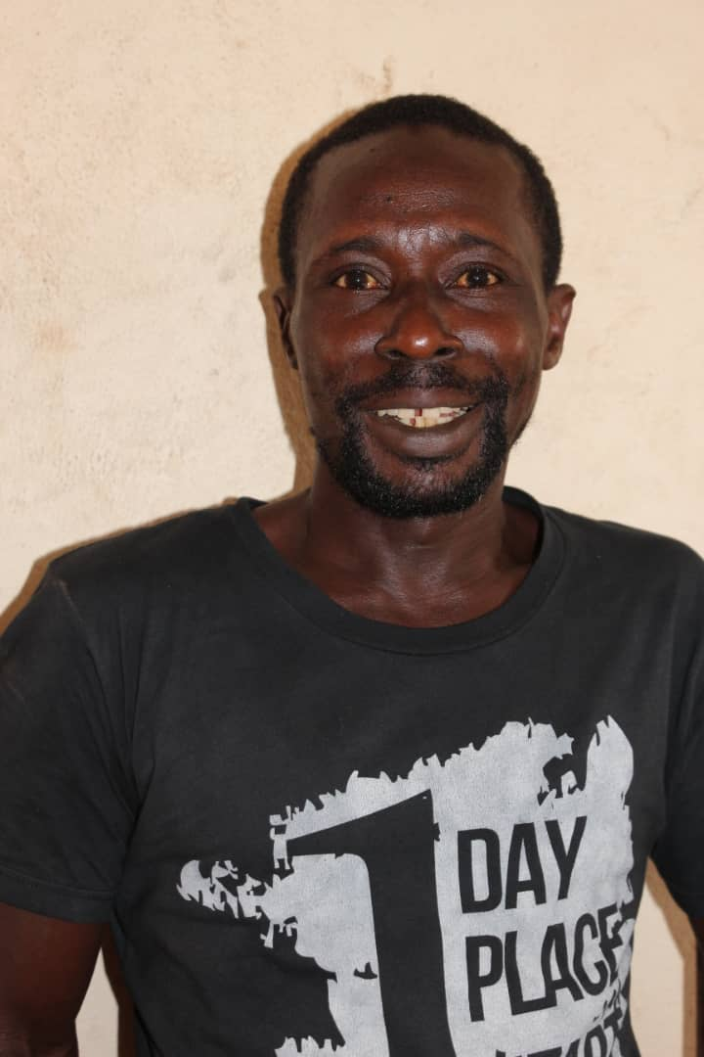
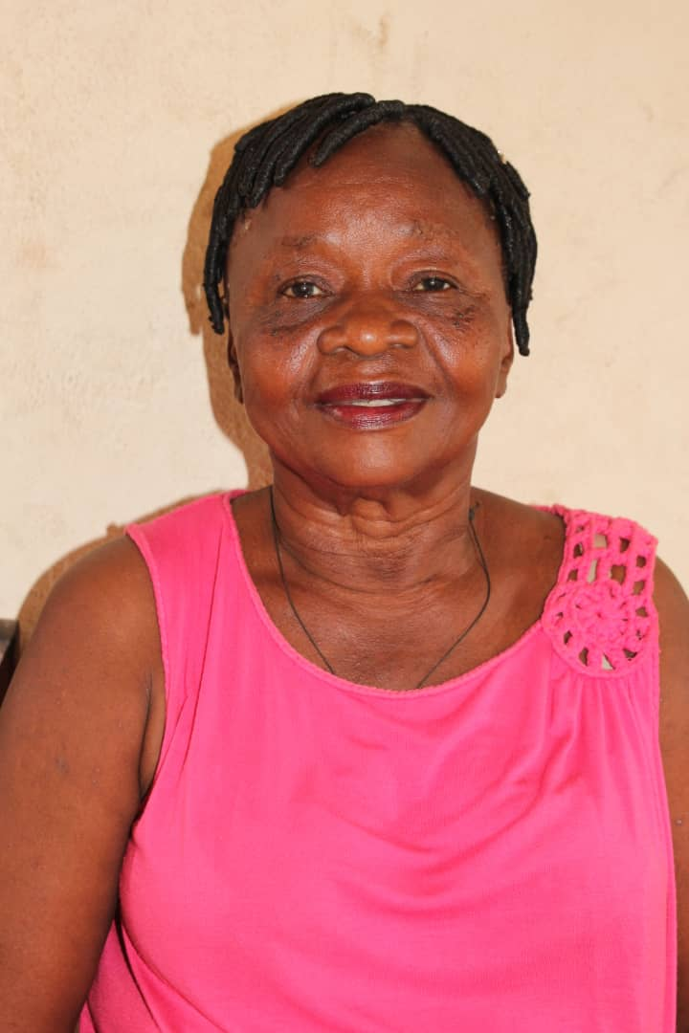
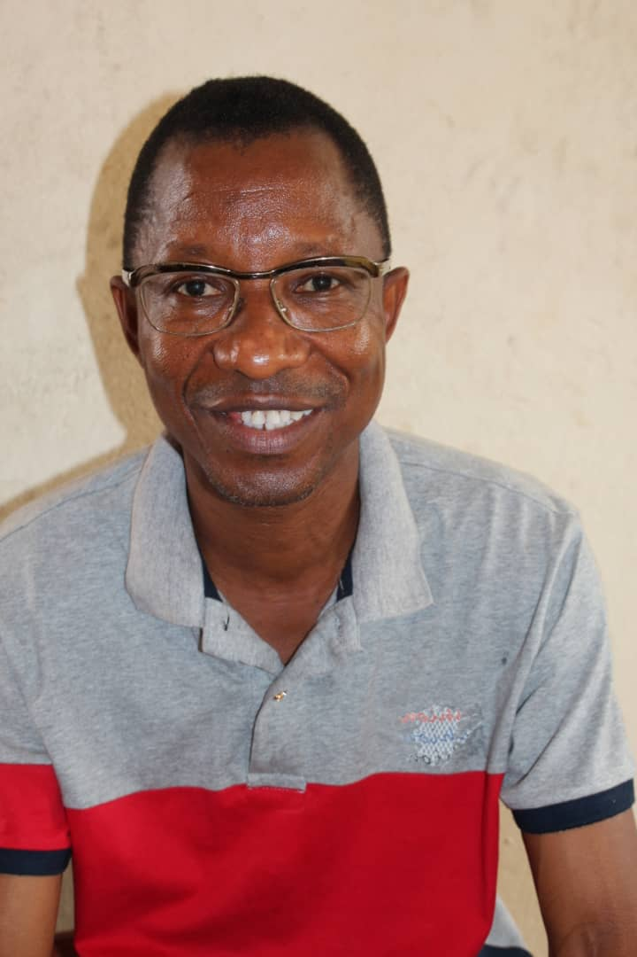
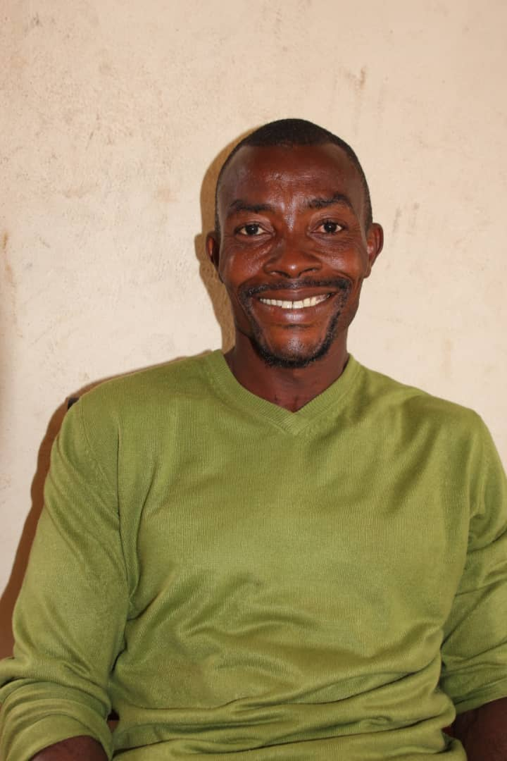
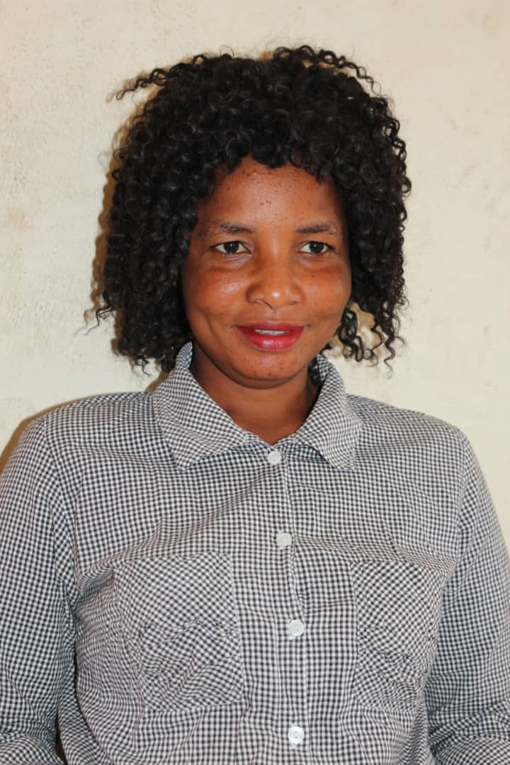
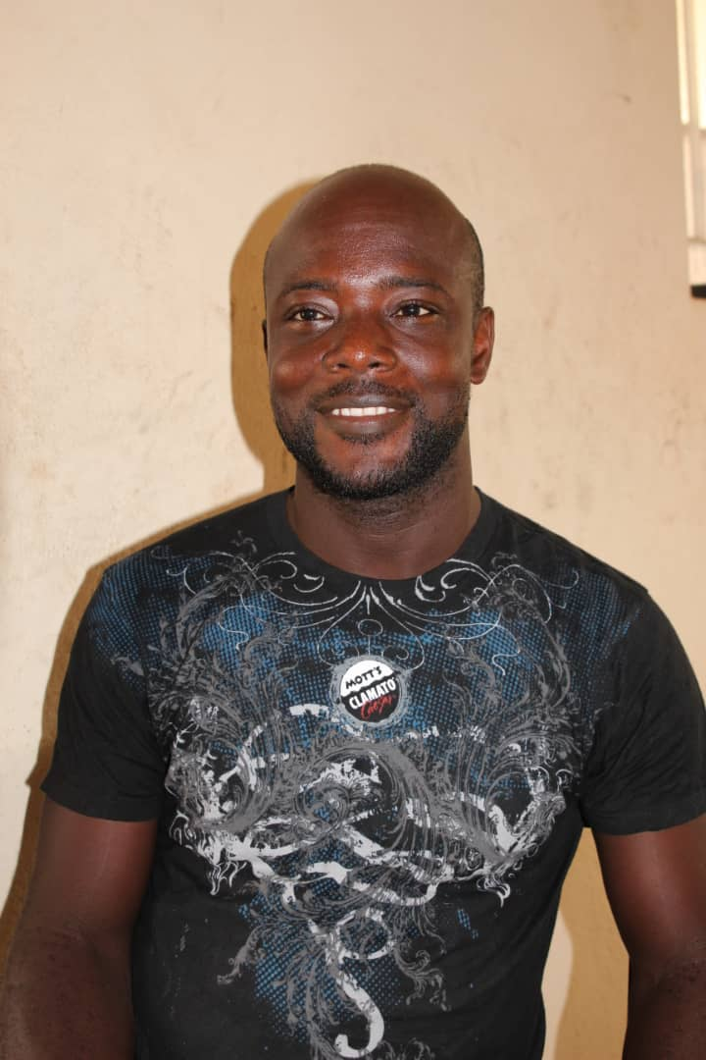
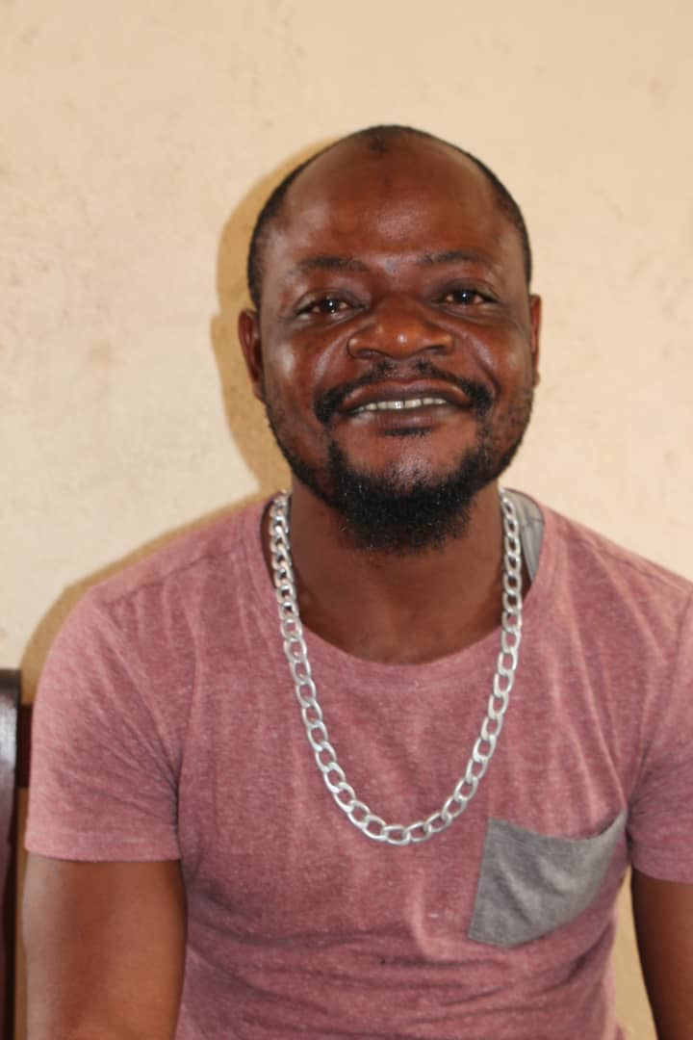
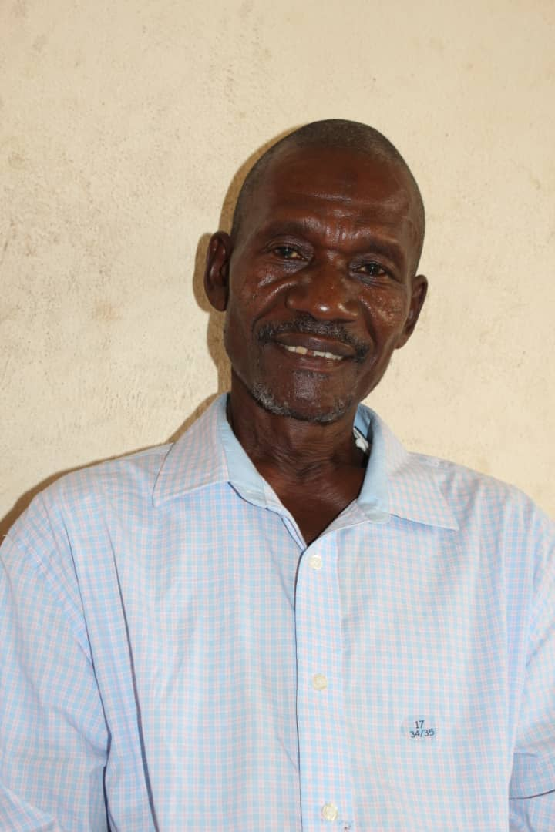
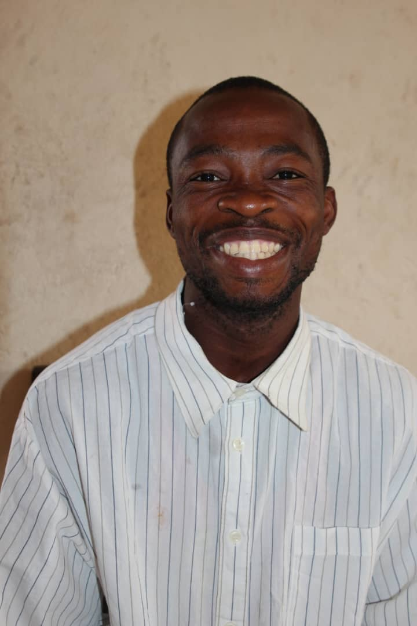
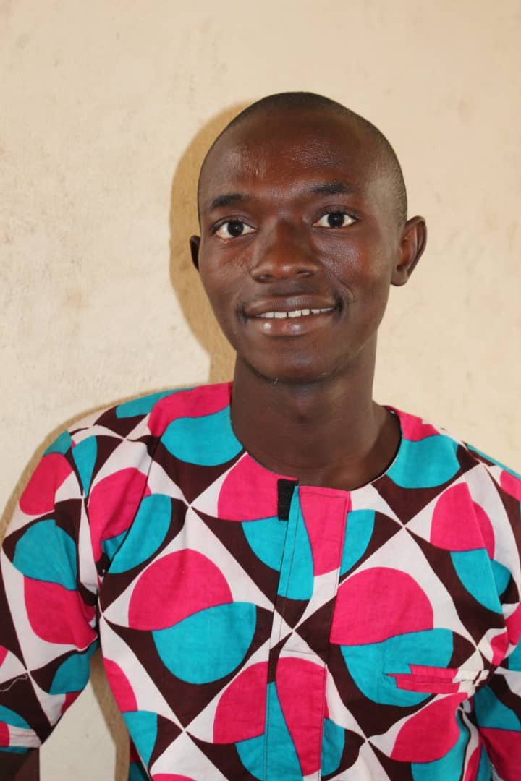
RHCI’s 11 Full Time Staff in Sierra Leone

Slide 22
RHCI’s Four Program Areas
1. Rural Health System Redevelopment in Tikonko Chiefdom
2. Mbaomi Mothers’ Home, a Maternity Waiting Home in Tikonko Town
3. Farm/Agriculture
4. Children’s Health Program
Notes:
1- Also could be called ”HEALTH SYSTEM STRENGTHENING”

Slide 23
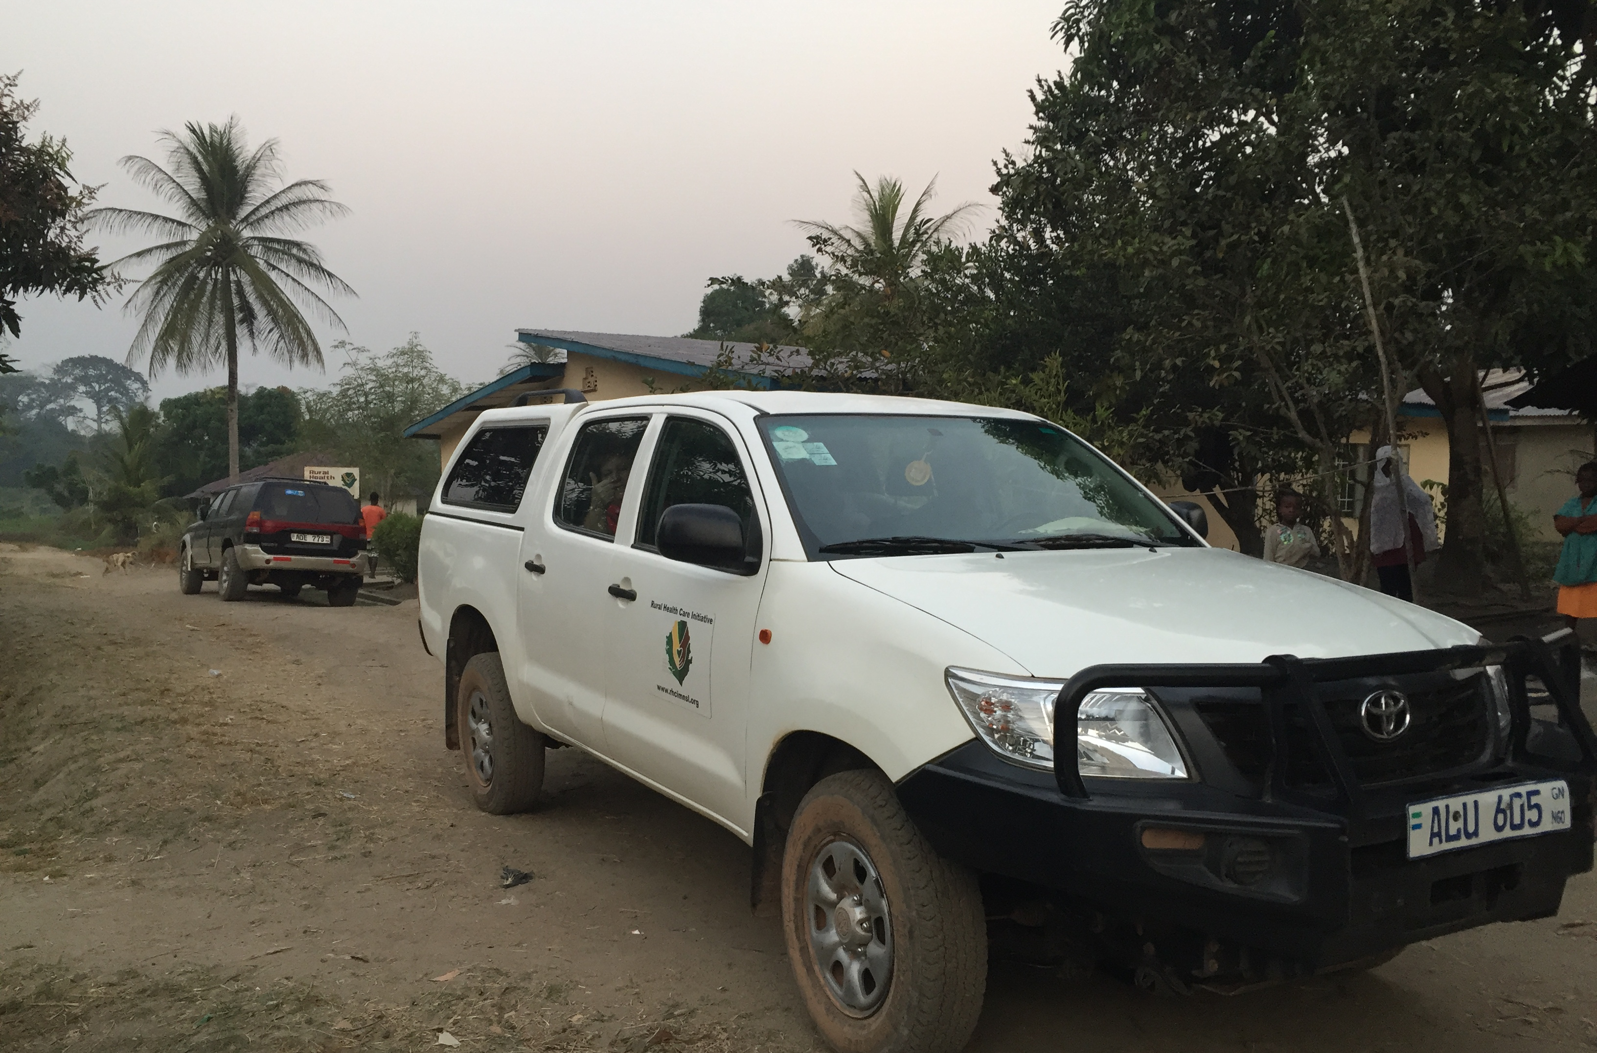
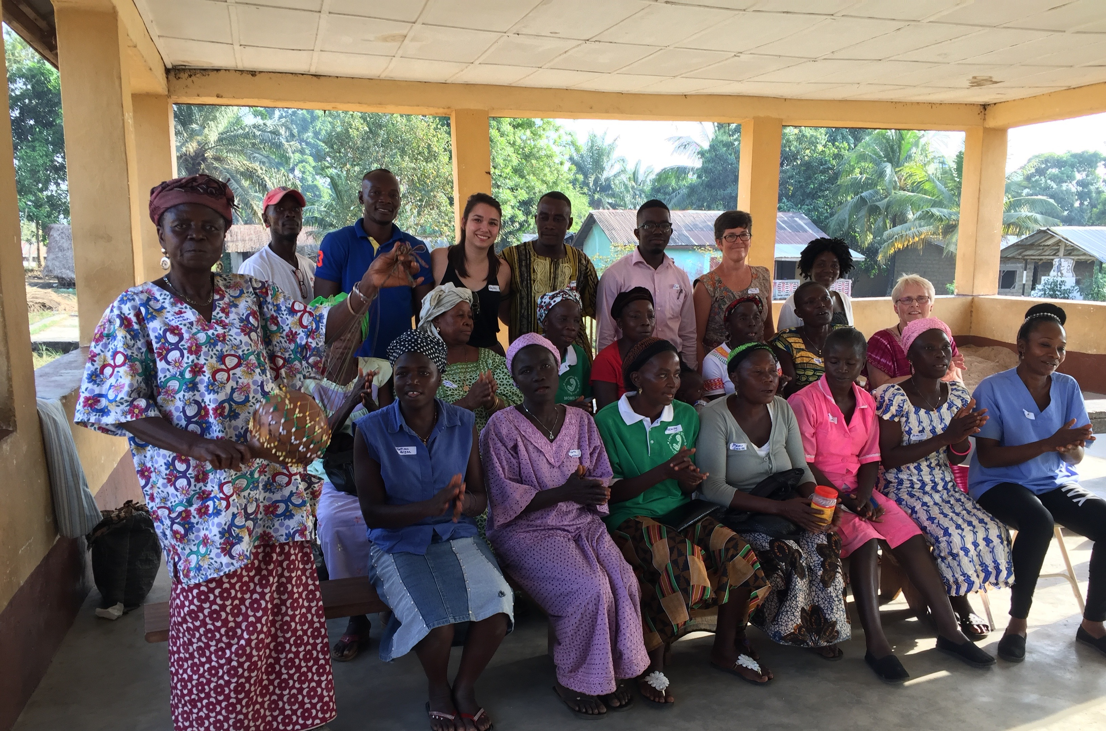
Rural Health System Re-development
by Strengthening existing health systems
Transportation, Trainings, donations of medical supplies, medication and support for 3 health units
Notes:
Read slide:
First program is Health system development and strengthening.
We do this through trainings , providing transportation for people needing health care, donations of medical supplies and other support for three health units, with plans to expand this fall to a 4th health clini.

Slide 24
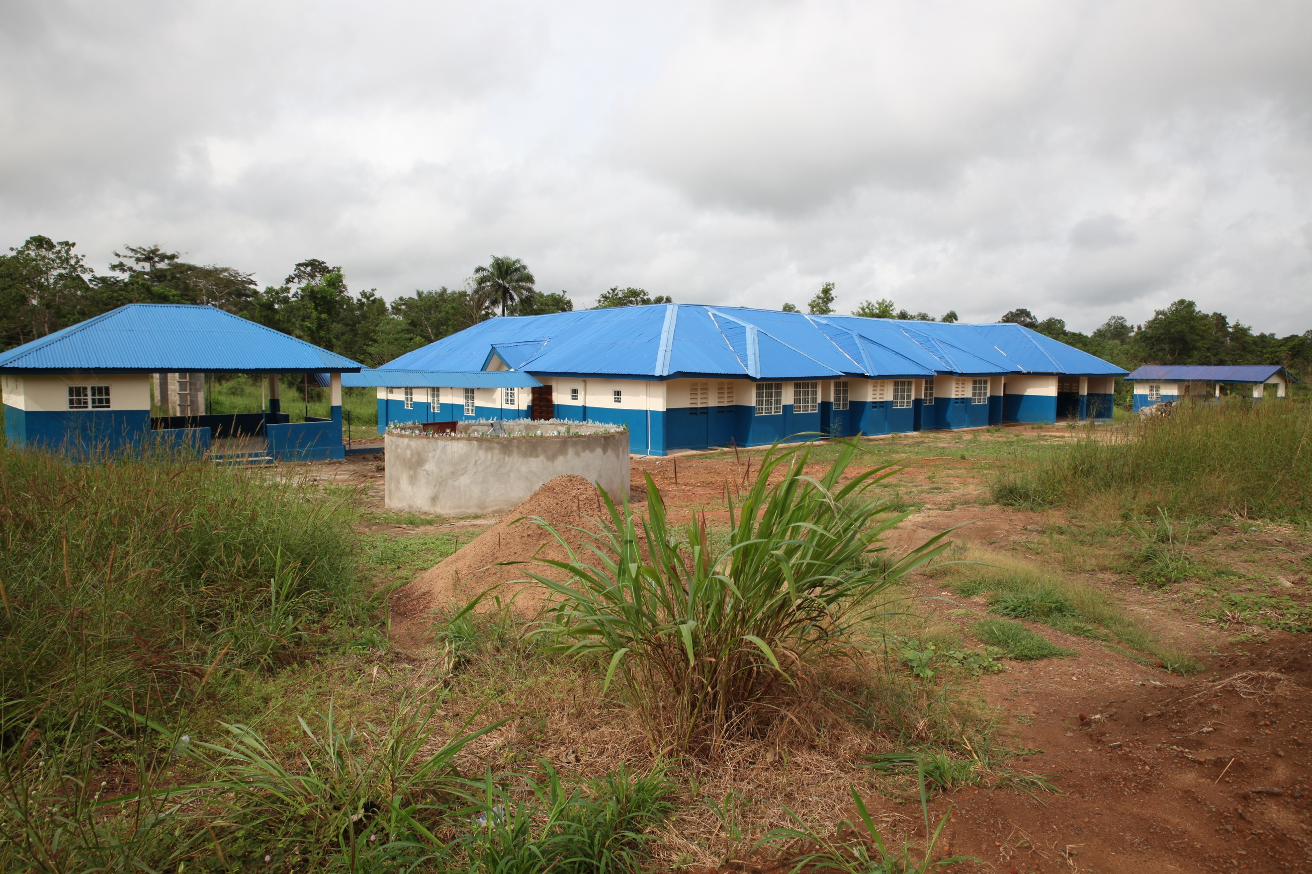
2- Mbao-mi Mothers’ Home—
Maternity Waiting Home
A place for mothers from distant villages to stay at the end
of pregnancy to have access to skilled care at childbirth.
Opened January 2018
Notes:
Our second program is the Mbaomi Mother’s Home; Read slide
Over 340 pregnant women have stayed there and maternal mortality has been zero.

Slide 25
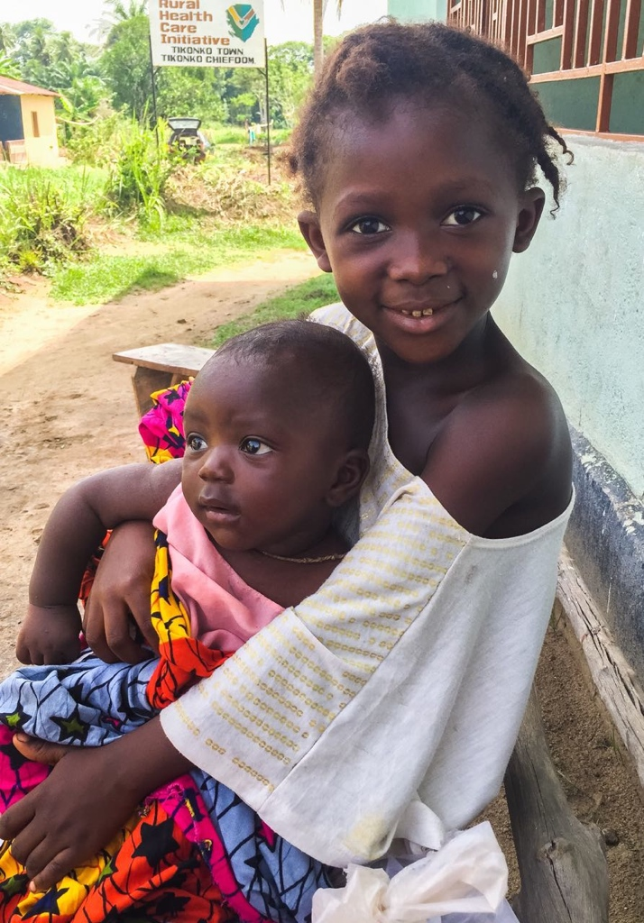
3-Children’s Health Program
Malnutrition Program
Transportation and Support for emergency and critical care at Bo Children’s Hospital
Support for Immunization campaigns
Notes:
The children’s health program includes a malnutrition program, …..read slide…..

Slide 26
4-Sustainable Food and Agriculture
Large Vegetable Garden and Fruit Orchard at Mbaomi Home
Three Farmer Based Organizations
Tikonko
Kpakuma
Julian

Slide 27
Opportunities
Be part of a medical advisory team for RHCI
Consider a medical volunteer trip to Tikonko, Sierra Leone in 2020 or 2021 with RHCI
Assist with fund development to support RHCI’s Programs

Slide 28
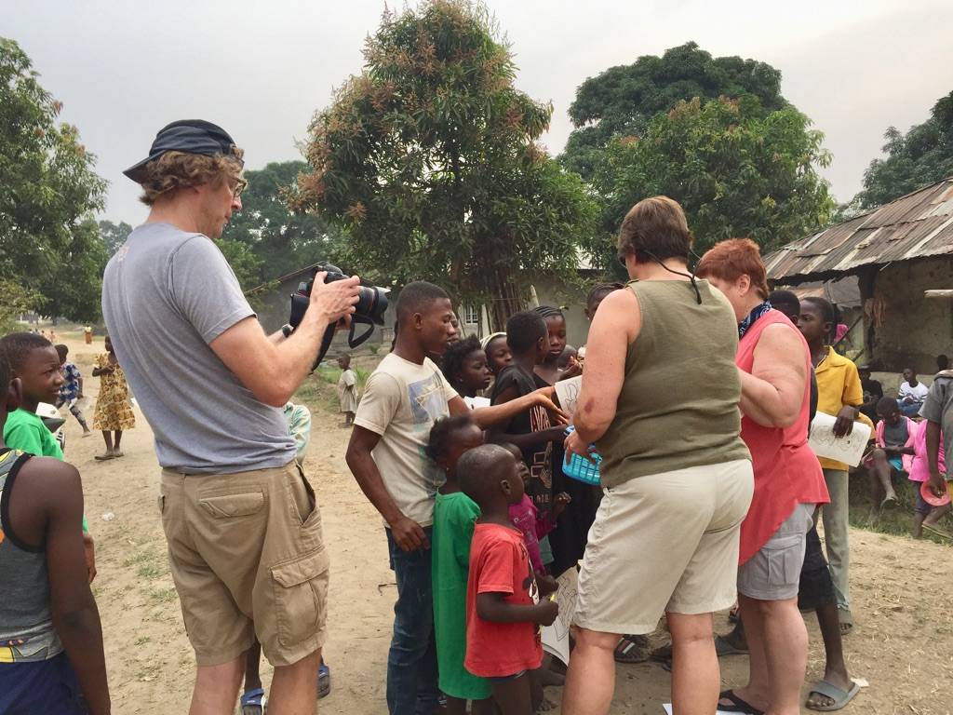
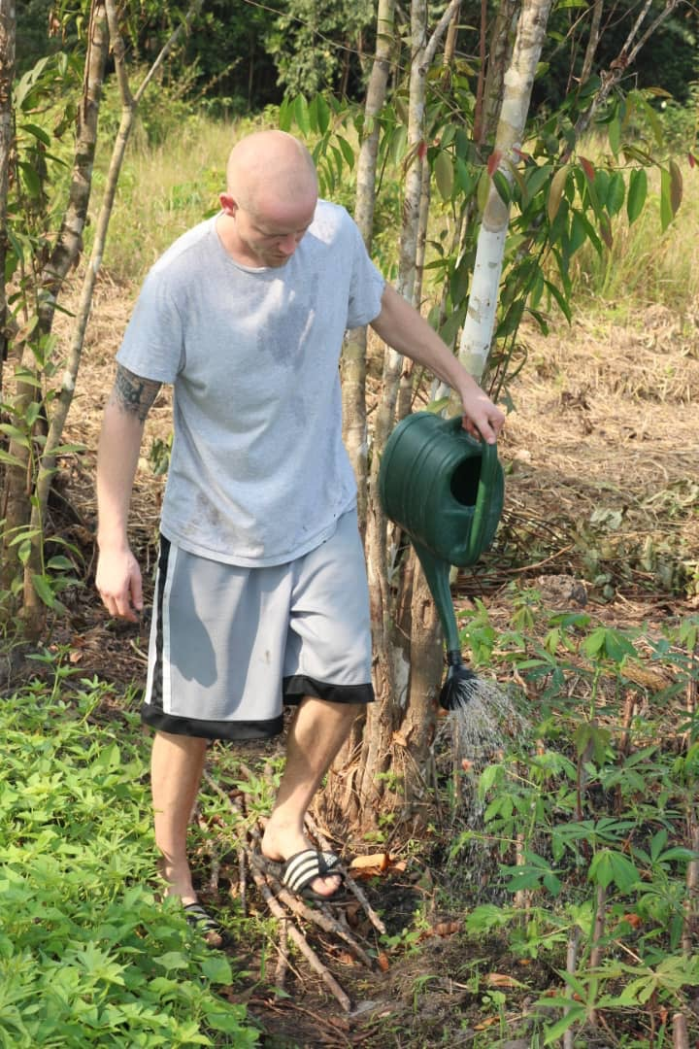
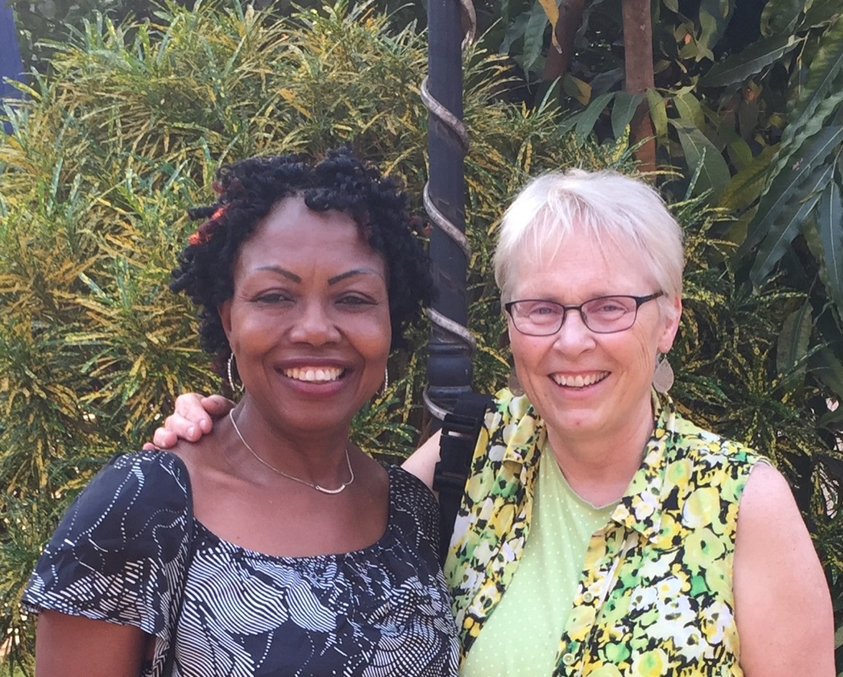
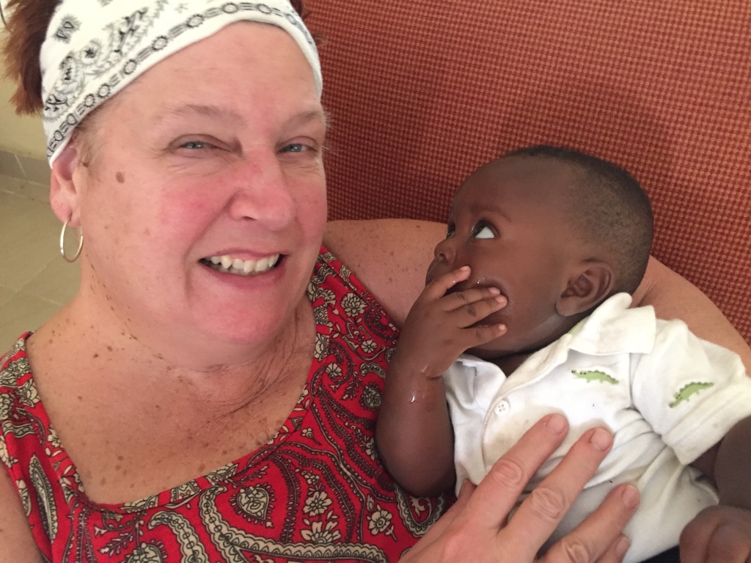
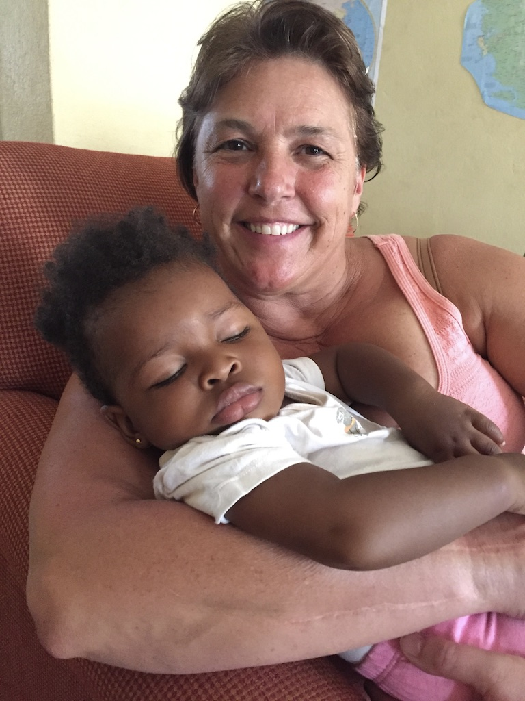

Slide 29
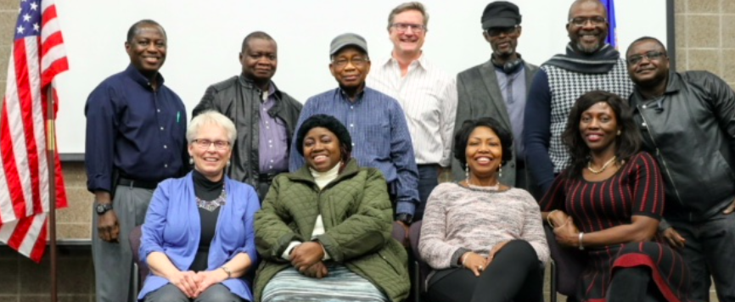
Thank you for attending RHCI’s first Global Health Roundtable!

